Slide 1
Audit & Assurance
Topic 9A
Evidence and Sampling
Podcast 1

Slide 2
Required Reading:
Chapters 11 & 13, ICAEW ‘Assurance’ textbook

Slide 3
The Audit Process
Start
Acceptance/ Continuance
Fieldwork
Completion
Audit Report
Planning

Slide 4
Evidence and Sampling
By the end of studying this topic, you should be able to:
Describe the procedures for obtaining evidence.
Recognise the strengths and weaknesses of particular forms of evidence
Recognise when sufficient, appropriate evidence has been obtained such that a conclusion can be drawn
Understand nature and methods of audit sampling

Slide 5
Lecture plan
Podcast 1
1. Audit evidence (revision)
2. Audit of accounting estimates
3. Inventories
Podcast 2
4. CAATs
5. Substantive analytical procedures
6. Data analytics
7 PPE
Podcast 3
8. Intangibles
9. Receivables
10. Audit sampling

Slide 6
Additional Reading
Self study - Chapters 9, 10 and 12 cover the topics Internal Audit, Documentation and Written Representations.
We have covered these topics throughout the module (e.g. internal audit – controls; written representation – evidence; documentation – throughout)
Reading these chapters will bring together and deepen your understanding of these topics

Slide 7
1. Audit Evidence (week 4)
Definition
Information used by the auditor in arriving at the conclusions on which the auditor’s opinion is based
ISA 500, Audit Evidence.
Audit evidence includes both the information contained within the accounting records underlying the financial statements, and other information gathered by the auditors, such as confirmations from third parties.

Slide 8
Sufficient Appropriate Audit Evidence (week 4)
 | Quality of Evidence
External | More reliable than evidence sourced from the entity
Auditor | Evidence is more reliable if sourced directly by the auditors
Entity | Entity generated evidence is more reliable when control systems operate effectively
Written | More reliable than oral evidence
Original | More reliable than photocopies

Slide 9
Obtaining audit evidence – audit procedures
Inspect (assets and documents)
Observe (eg segegation of duties)
Inquiry (of management)
External confirmation (eg from bank or suppliers)
Recalculation (eg adding up invoice)
Reperformance (eg with CAAT)
Analytical procedures (substantive)

Slide 10
Evidence gathering audit procedures
There are more different ways evidence can be obtained by the auditor (use active verbs if asked for audit procedures)
Vouch
Agree
Reconcile
Cast
Review
Ascertain
Trace
Compare
Obtain

Slide 11
Scoping – Tesco audit report: 2020 Deloitte
“Our Group audit was scoped by obtaining an understanding of the Group and its environment, including Group-wide controls, and assessing the risks of material misstatement at the Group level.”
“Our audit scoping provides full scope audit coverage of 96% (2018/19: 95%) of revenue and 92% (2018/19: 94%) of net assets.”

Slide 12
2. Audit of Accounting Estimates
Depreciation
Examples:
Not a result of transactions with third parties
Based on management judgement
Inventory valuation
Provisions e.g. warranty
Less reliable evidence available
Risk of management bias

Slide 13
Audit of Accounting Estimates
Requires professional scepticism
ISA 540 Auditing Accounting Estimates sets out the appropriate audit approach.
Risk assessment procedures should identify risk of material misstatement due to accounting estimates.
Estimation uncertainty is a key risk (ie inherent lack of precision in measurement).

Slide 14
Audit of Accounting Estimates
Method | Example
Test the process management used to estimate the figure and the data upon which the estimate is based | Compare estimate with past experience, check the calculation and consider any factors that would have affected the current year figure
Use a ‘point estimate’ | There may be standard models available for comparison. Compare with range estimates
Review events occurring up to the date of the auditor’s report (ie post year end) | More evidence may be available after the balance sheet date
Test effectiveness of any controls over the estimate plus substantive procedures (e.g. analytical procedures) | Appropriate if there are controls over the estimation and if the estimate is derived from the routine processing of data

Slide 15
3. Inventory: Procedures to Obtain Evidence
Assertions
Rights and Obligations
Existence
Completeness
Accuracy, Valuation and Allocation
Classification
Presentation
What audit evidence can we obtain to support these assertions?

Slide 16
Inventory – Risks of Material Misstatement (what can go wrong?)
Inventory that does not exist may be included in the financial statements (existence) = overstatement
Not all inventory may be included in the financial statements = understatement (completeness)
Inventory may be included in the financial statements at full value when it is obsolete or damaged - cost v NRV (valuation)
Inventory may be included in the financial statements at the wrong value - (valuation)
Inventory that belongs to third parties may be included in the financial statements (rights)
Inventory that has already been sold may be included in the financial statements - (cut-off)

Slide 17
Inventory Count (Stock count)
Most entities will carry out an inventory count at the year-end
Auditors will evaluate and test the controls over inventory counting
Auditors will usually attend the inventory count to test controls and perform substantive procedures
Some companies may have a perpetual inventory system which means regular inventory counts are less necessary

Slide 18
Controls over Inventory Count
Refer to your lectures on internal control for information on controls over inventory counts
Refer also to textbook chapter 13 for example controls over inventory counts

Slide 19
Cost Vs NRV
Indications inventory might be impaired include:
An increase in cost or fall in sales price
Physical deterioration (can be observed at inventory count)
Obsolescence of product (older inventories)
Loss leader strategy (artificially low prices)
Production errors
Auditors should compare cost to NRV – see chapter 13 of textbook for example

Slide 20
Cost v NRV - Example
£
per unit
Selling price 200
Transport cost to customer (35)
Completion costs (40)
NRV per unit on inventory 125

Slide 21
Cost v NRV - Example (cont)
Inventory cost per unit £
per unit
Raw materials 50
Production labour 25
Production overheads variable 10
Production overheads fixed 60
Total cost per unit 145
Conclusion – write down inventory from 145 to its NRV of 125

Slide 22
Andromeda Industries
Inventory Count

Slide 23
Andromeda Industries - Question
Inventory count
Andromeda’s raw materials and finished goods inventory are stored in 12 warehouses across the country.
Each of these warehouses is expected to contain material levels of inventory at the year end. It is expected that there will be no significant work in progress held at any of the sites.
Each count will be supervised by a member of Andromeda’s internal audit department and the counts will all take place on 31 December, when all movements of goods in and out of the warehouses will cease.
Requirement
Describe audit procedures you would perform during the audit of Andromeda BEFORE and DURING the inventory counts.

Slide 24
Andromeda Industries - solution
Before inventory count
Review prior year audit files
Discuss inventory count with management (new warehouses; control issues)
Select sample of warehouses to attend inventory count
Review inventory count instructions from management

Slide 25
Andromeda Industries - solution
During inventory count
Observe counting to confirm procedures
Sample inventory and perform test counts
Confirm procedures for identifying damaged and slow moving goods
Observe that all inventory movements have ceased
Obtain copies of all sequentially numbered inventory sheets for follow-up testing
Note last GRN and delivery note (cut-off)

Slide 26
Audit & Assurance
Topic 9A
Evidence and Sampling
Podcast 2

Slide 27
Lecture plan
Podcast 1
1. Audit evidence (revision)
2. Audit of accounting estimates
3. Inventories
Podcast 2
4. CAATs
5. Substantive analytical procedures
6. Data analytics
7 PPE
Podcast 3
8. Intangibles
9. Receivables
10. Audit sampling

Slide 28
Andromeda Industries
Inventory Count

Slide 29
Andromeda Industries - Question
Inventory count
Andromeda’s raw materials and finished goods inventory are stored in 12 warehouses across the country.
Each of these warehouses is expected to contain material levels of inventory at the year end. It is expected that there will be no significant work in progress held at any of the sites.
Each count will be supervised by a member of Andromeda’s internal audit department and the counts will all take place on 31 December, when all movements of goods in and out of the warehouses will cease.
Requirement
Describe audit procedures you would perform during the audit of Andromeda BEFORE and DURING the inventory counts.

Slide 30
Andromeda Industries - solution
Before inventory count
Review prior year audit files
Discuss inventory count with management (new warehouses; control issues)
Select sample of warehouses to attend inventory count
Review inventory count instructions from management

Slide 31
Andromeda Industries - solution
During inventory count
Observe counting to confirm procedures
Sample inventory and perform test counts
Confirm procedures for identifying damaged and slow moving goods
Observe that all inventory movements have ceased
Obtain copies of all sequentially numbered inventory sheets for follow-up testing
Note last GRN and delivery note (cut-off)

Slide 32
4. Computer Assisted Audit Techniques (CAATs)
Auditors may use ‘Computer Assisted Audit Techniques’ (CAATs)
Test data
Audit software
To identify procedures that auditors may use CAATs for, think of normal audit procedures and consider whether the information can be obtained from the client’s computer system

Slide 33
Computer Assisted Audit Techniques (CAATs)
 | AUDITOR | COMPANY
Using test data (eg dummy transactions) | DATA | SOFTWARE
Using audit software | SOFTWARE | DATA

Slide 34
Test Data (ie. auditor’s data)
Tests controls within the client’s accounting system:
Identify controls within the client’s system
Decide upon the test data to use:
Dummy data
Real data
Dummy data run through a copy of the system
Run the test data
Compare results with expectations
Conclude on whether controls are operating effectively

Slide 35
Test Data - Examples
An invoice which does not cast (add up) should be rejected by the system
An invoice with an incorrect supplier code should be rejected
Valid entries should be correctly posted to the appropriate account
A sales order which would exceed customer’s credit limit should be rejected by the system.

Slide 36
Audit Software (auditor’s software)
Interrogates the client’s system and analyses selected information
Extract a sample according to specified criteria e.g. balances over a certain amount
Calculate ratios and select those outside expectations
Check calculations performed by the system
Prepare reports such as budget figures compared with actual figures
Can test whole population

Slide 37
Delphic Ltd is a wholesaler of furniture. Delphic buys the furniture from six major manufacturers and sells them to over 600 different customers ranging from large retail chain stores to smaller owner-controlled businesses.
The receivables balance includes customers owing up to £125,000 to smaller balances of about £5,000, all with many different due dates for payments and credit limits. All information is stored on Delphic’s computer systems.
You are the audit senior in charge of the audit of the receivables balance. For the first time at this client, you have decided to use audit software. Staff at Delphic are happy to help the auditor, although they cannot confirm completeness of systems documentation, and warn that the systems have very old operating systems in place, limiting file compatibility with more modern programs.

Slide 38
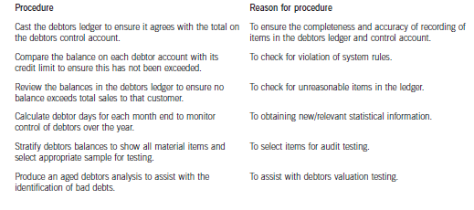

Slide 39
5. Analytical Procedures
Analytical Procedures can be used at three different stages of the audit:
Beginning – Preliminary AP (as part of planning)
Middle – Substantive AP (gathering audit evidence as part of substantive procedures. Auditors are not required to do this by ISA)
End – Review AP (part of audit completion)

Slide 40
Analytical Procedures
ISA 520 Analytical Procedures gives detail on using analytical procedures in the audit process
Substantive procedures are required to be performed on all material balances, this may include substantive analytical procedures
Remember: it is compulsory at the planning stage to use analytical procedures

Slide 41
Factors to Consider When Using Analytical Procedures
Factor | Issues to consider
Suitability | More applicable for large volumes of predictable data. Need to consider whether other audit procedures are available which would provide corroboration or further evidence (Benchmarks)
Reliability of data | The source of information, comparability of information, nature and relevance of information, whether there are appropriate controls over data
Precision | The accuracy with which results can be predicted and the extent to which information can be disaggregated
Acceptable difference | Influenced by materiality and required assurance: higher risk, lower tolerance to differences

Slide 42
Income Statement Items
Revenue, purchases and employee costs are tested predominantly through tests of controls (Topics 6, 7 & 8)
Also involve use of analytical procedures as amounts are usually of a predictable nature and involve large volumes of transactions.
The level of risk associated with income statement items would affect whether other substantive procedures were required in addition to analytical procedures (e.g. tracing transactions through to invoices and payments)

Slide 43
Examples of data for comparison
Interim financial information
Budgets
Management accounts
Non-financial information
Industry information
Tax returns
Board minutes

Slide 44
Analytical Procedures: Things to Consider
If significant differences from expectations occur, the auditor needs to investigate this.
Management responses need to be corroborated otherwise other audit procedures would need to be performed
Effectiveness of the client’s controls will affect the reliability of the data

Slide 45
6. What is Data Analytics?
Definition
The process of inspecting, cleaning, transforming, analysing and modeling data with the goal of highlighting useful information, suggesting conclusions, and supporting decision making.
Data analytics is an analytical process by which insights are extracted from operational, financial, and other forms of electronic data internal or external to the organisation.

Slide 46
Data Analytics
Data analytics insights can be historical, real-time, or predictive and can also be:
risk-focused (e.g. controls effectiveness, fraud, waste, abuse, policy/regulatory noncompliance); or
performance-focused (e.g. increased sales, decreased costs, improved profitability)
Example: PwC Halo system

Slide 47
Data Analytics - examples
Example 1
Extract from client’s accounting system all sales transactions (credits) where the corresponding debit entry is neither receivables nor cash.
Example 2
Extract from client’s accounting system all journal entries which are:
Dr PPE
Cr Any expense a/c

Slide 48
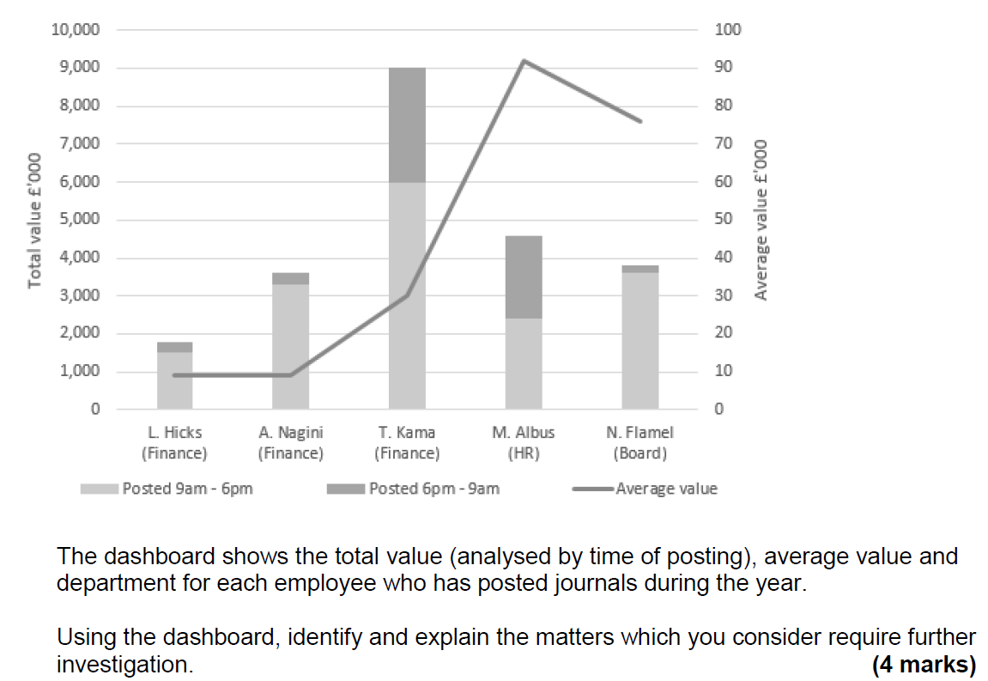
Data Analytics - Week 4 revision

Slide 49
Data Analytics

Slide 50
7. PPE
PPE: Assertions
Existence
Rights and Obligations
Completeness
Accuracy, Valuation and Allocation
Classification
Presentation
What audit evidence can we obtain to support these assertions?

Slide 51
PPE: Risks of Misstatement
The company may not own (or control) the assets (rights)
The assets may not exist or may have been sold (existence and rights)
Assets may be omitted (completeness)
Assets may be overvalued either by inflating cost or valuation, or by undercharging depreciation (valuation)
The assets may be incorrectly presented in the financial statements (presentation)

Slide 52
PPE - Procedures to Obtain Evidence
Rights (assets) and Obligations (liabilities):
Inspect ownership documents available for non-current assets
Review sales invoices for any ‘disposals’ (assets sold within the year) to ensure ownership has been transferred
Existence
Physically inspect assets

Slide 53
Procedures to Obtain Evidence
Completeness (understatement)
Obtain a schedule of non-current assets
Agree total per schedule to draft financial statements and accounting records (nominal ledger)
Select a sample of assets physically present on site and ensure they are included on schedule
Confirm additions (new assets purchased during the year) have been correctly included in the schedule

Slide 54
Procedures to Obtain Evidence
Valuation
Agree the cost of a sample of assets included in the schedule to purchase invoices
Agree the opening accumulated depreciation to prior year audit file (assuming your firm was the auditor in the prior year)
Re-calculate annual depreciation charge for a sample of assets and agree rate used to depreciation policy
Re-calculate depreciation charged on disposed assets and re-calculate profit or loss on sale of the assets

Slide 55
PPE – areas to test
Additions
Disposals
Depreciation
Opening balances
Impairment

Slide 56
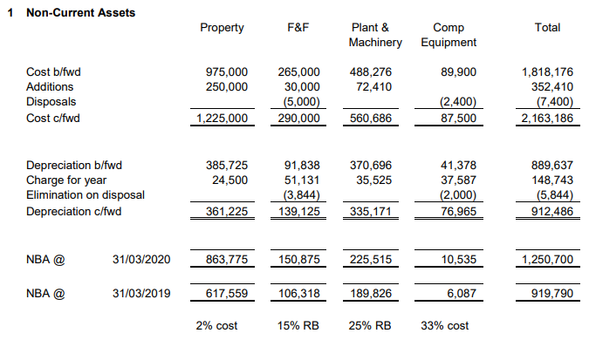

Slide 57
Pippa Burgers Co
PPE

Slide 58
Pippa Burgers Co - Solution
In the past, Pippa Burgers received negative press reports over the condition of its fast-food restaurants, with comments suggesting they are old fashioned and tired looking.
Therefore, during the year ended 31 March 20X7, Pippa undertook a full review of all its property and equipment and carried out extensive refurbishments to the majority of its restaurants.
This review resulted in a significant amount of the older fixtures and fittings being disposed of and a significant amount of capital expenditure was invested in all remaining restaurants.
Requirement
Describe the substantive procedures you should perform to obtain sufficient and appropriate audit evidence in relation to Pippa’s property, plant and equipment.

Slide 59
Audit & Assurance
Topic 9A
Evidence and Sampling
Podcast 3

Slide 60
Lecture plan
Podcast 1
1. Audit evidence (revision)
2. Audit of accounting estimates
3. Inventories
Podcast 2
4. CAATs
5. Substantive analytical procedures
6. Data analytics
7 PPE
Podcast 3
8. Intangibles
9. Receivables
10. Audit sampling

Slide 61
Pippa Burgers Co
PPE

Slide 62
Pippa Burgers Co - Solution
In the past, Pippa Burgers received negative press reports over the condition of its fast-food restaurants, with comments suggesting they are old fashioned and tired looking.
Therefore, during the year ended 31 March 20X7, Pippa undertook a full review of all its property and equipment and carried out extensive refurbishments to the majority of its restaurants.
This review resulted in a significant amount of the older fixtures and fittings being disposed of and a significant amount of capital expenditure was invested in all remaining restaurants.
Requirement
Describe the substantive procedures you should perform to obtain sufficient and appropriate audit evidence in relation to Pippa’s property, plant and equipment.

Slide 63
Pippa Burgers Co - Solution
Additions
Obtain a breakdown of additions
Confirm sample of additions to invoice
Confirm additions are capital (not expenses)
Physically inspect to confirm existence
Inspect maintenance account for PPE items
Disposals
Obtain a breakdown of disposals
Confirm sample of disposals and agree to invoice to confirm sales proceeds
Recalculate profit/loss on disposal

Slide 64
Pippa Burgers Co - Solution
Depreciation
Recalculate depreciation for sample
Review disclosures
Opening balances
Agree opening balances to prior year audit file
Impairment
Confirm additions are PPE (not expenses)
Physically inspect for damage or faults
Make enquiries of management and board minutes for evidence of impairment

Slide 65
8. Intangible Assets: Procedures to Obtain Evidence
Assertions
Rights and Obligations
Existence
Completeness
Accuracy, Valuation and Allocation
Classification
Presentation
What audit evidence can we obtain to support these assertions?

Slide 66
Intangible Assets: Examples
Purchased goodwill – acquisition of another business
Purchased – eg brands, patents, licences
Internally generated – eg development costs

Slide 67
Intangible Assets – Risks of Misstatement
Expenses may be capitalised (included within intangible assets) incorrectly (valuation)
Intangible assets may be incorrectly recognised if the company does not own the rights to the asset (rights)
Intangible assets may be carried at the wrong cost or valuation due to incorrect amortisation (valuation)
Impairment reviews not being carried out appropriately (valuation)

Slide 68
Intangible Assets: Procedures to Obtain Evidence
Rights and Obligations
Agree a sample of intangible assets to purchase invoices (if purchased)
Agree to legal documents (eg intellectual property rights)
Existence
Examine schedule of additions to ensure only capital items have been included

Slide 69
Intangible Assets: Procedures to Obtain Evidence
Completeness
Obtain a schedule of intangible assets
Agree the figure per the schedule to draft financial statements and nominal ledger
Confirm additions (new assets purchased during the year) have been correctly included in the schedule
Confirm internal costs relating to intangibles (eg development costs)

Slide 70
Intangible Assets: Procedures to Obtain Evidence
Valuation
Obtain client calculations of impairment reviews and re-perform calculations
Assess reasonableness of assumptions used in impairment reviews
Assess whether any conditions that may indicate impairment are present in the client
Consider whether a specialist is required to value the asset
Re-calculate amortisation charge for a sample of assets

Slide 71
9. Receivables
Significant Risks:
Debts are uncollectable (valuation) Can’t pay
Debts are contested by customers (existence, rights and obligations) Won’t pay
What external / third party evidence is available to support these assertions?

Slide 72
Receivables: Audit Procedures
Perform a trade receivables circularisation of a sample of year-end balances (see later)
Check receipt of cash after year end
Inspect the aged receivables report to identify any slow moving balances
Confirm validity of sales to despatch notes
Test company’s controls over issue of credit notes and write-offs of irrecoverable debts
Trace sales invoices just before year end to year end receivables balance (cut off test)

Slide 73
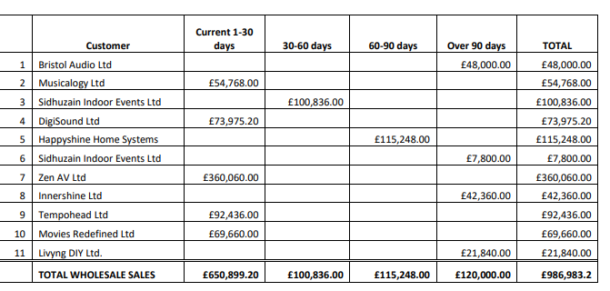
Aged analysis of receivables

Slide 74
Receivables: Audit Procedures (cont)
Calculate average receivables days and compare this to prior year.
Review the reconciliation of sales ledger control account to the sales ledger list.
Select a sample of despatched notes before and just after the year end and follow through to the sales invoice to ensure they are recorded in the correct accounting period.
See textbook for example of receivables audit.
See solution to Dashing Co question.

Slide 75
Confirmations from Customers / Receivables Circularisations
Auditors would obtain direct confirmation from a sample of customers (ISA 505: External Confirmations)
The client needs to request the information (as hopefully customers wouldn’t divulge confidential information to unauthorised parties)
Auditor would normally send the request – more reliable evidence if auditor generated
Assertions: existence & rights and obligations

Slide 76
Confirmations from Customers / Receivables Circularisations
Positive confirmation – requests customer to reply confirming the amount owed at the balance sheet date
Negative confirmation – customer replies only if they disagree with the amount owed
See solution to Dashing Co question for circularisation procedures
More reliable evidence provided

Slide 77
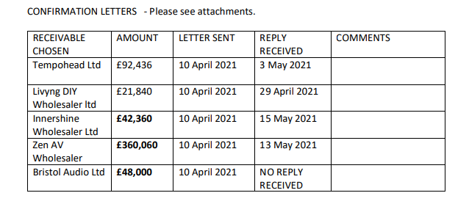
Circularisation of receivables

Slide 78
Selecting a Receivables sample
Need to consider in particular:
Old, unpaid accounts
Accounts written off during the period
Accounts with credit balances
Accounts settled in round sum amounts
Also need to consider:
Large balances (overstatement risk)
Accounts with nil balances (understatement risk)
Assurance providers will need to perform further work where disagreements arise (or no reply is received)

Slide 79
Aged analysis of receivables
“Virtual Desk and Filing System”
“Interim Visit – Sales Systems – documents and resources”
Go through the following video:
“Sheridan AV: Aged Debtor Analysis”
Note: Debtors = Receivables
https://blackboard.uwe.ac.uk/bbcswebdav/orgs/ACC/simulations/auditsim_0919_xg/auditsim_web/auditsim_files/intro.html

Slide 80
10. Audit Sampling - Definition
Audit sampling is the application of an audit procedure to less than 100% of the items within an account balance or class of transactions for the purpose of evaluating some characteristic of the balance or class.
Applies to:
Tests of details
Tests of controls

Slide 81
Sampling Risk
Likelihood (ie probability) that the decision based on the sample differs from the decision that would have been made if the entire population were examined
Caused by selecting a non-representative sample
Can be controlled by:
Determining an appropriate sample size
Ensuring that all items have an equal likelihood of selection (or probability of selection proportional to size)
Evaluating sample results in order to control risk

Slide 82
Non-sampling risk
Likelihood that an incorrect conclusion is drawn for reasons unrelated to the sample
Most common cause is mistakes in evaluating sample items

Slide 83
Approaches to Sampling
Statistical sampling applies laws of probability in selecting sample items and evaluating sample results
Allows audit team to control exposure to sampling risk
Non-statistical sampling (eg judgement sampling) does not allow audit team to control exposure to sampling risk
Both statistical sampling and non-statistical sampling are appropriate under GAAS

Slide 84
Effect of Factors on Sample Size
Factor | Effect on sample size | Explanation
Population size | Insignificant | As population is larger sample increases but will normally be insignificant
Expected rate of deviation (Expected misstatement) | Direct | As auditors expect higher level of deviations or misstatements in population, need to sample more items
Tolerable rate of deviation (Tolerable misstatement) | Inverse | As auditors tolerate lower levels of deviations (or misstatements), need to sample more items
Sampling risk | Inverse | As auditors wish to reduce chance of incorrect decisions, need to sample more items
Population variability | Direct | As population is more variable, need to sample more items to obtain representative sample
Risk of material misstatement | Direct | As auditors expect higher level of risk in population, need to sample more items to reduce detection risk

Slide 85
Homework
Read study manual – Chapters 11 and 13
Cragg – attempt question for Synchronous session on Monday
Questions on CANVAS

